Slide 1

Compiler Construction
Muhammad Awais Ali
Department of Computer Science
University of Management & Technology- Lahore

Slide 2
About me
MS in Computer Science from COMSATS University
Previous Experience:
“Worked as a Lecturer at COMSATS University from January 2020 to August 2021”
“Worked as a Lecturer at University of Lahore from September 2021 to November 2022”

Slide 3
Class Introduction
Your Name
Current Status (programming languages, cgpa, where you from, etc.)

Slide 4
Policies and Guidelines
Attendance policy: marking at start
Plagiarism policy: as per outline
Do’s
Be interactive
Participate in the lecture
Relax and learn
Don’ts
Use of cell phones
Discussion with fellows during class (unless told otherwise)
Early leave (may result in absent)

Slide 5
Compiler
A program much be translated into a form in which it can be executed by a computer.
The software systems that do this translation are called compiler

Slide 6
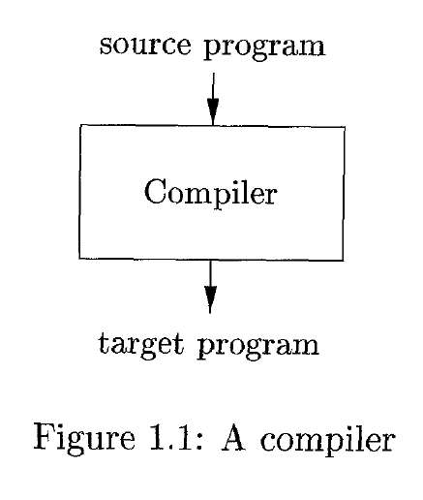
Compiler
A compiler is a program that can read a program in one language - the source language - and translate it into an equivalent program in another language - the target language

Slide 7
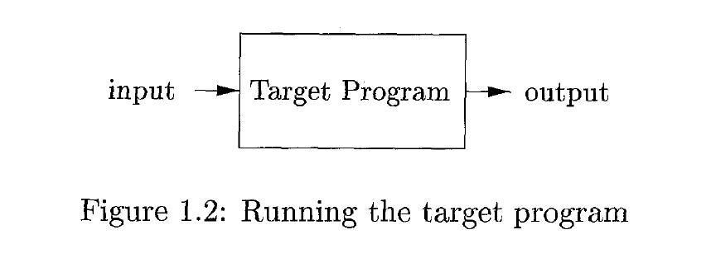
Compiler
An important role of the compiler is to report any errors in the source program that it detects during the translation process.
If the target program is an executable machine-language program, it can then be called by the user to process inputs and produce outputs;

Slide 8
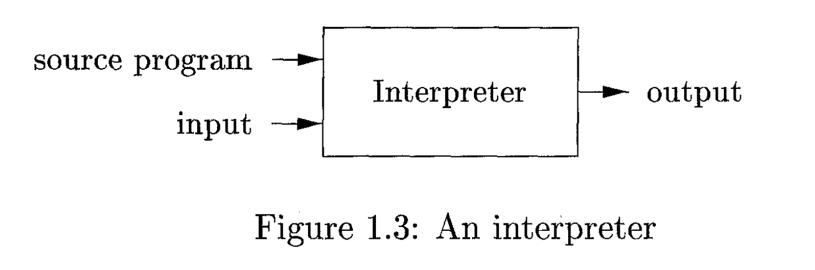
Interpreters
An interpreter appears to directly execute the program and provide output.
An interpreter translates the code line by line when the program is running.

Slide 9
Compiler vs. Interpreter
A compiler takes an entire program and a lot of time to analyze the source code, whereas the interpreter takes a single line of code and very little time to analyze it.
Slow processing in compilation
A compiler displays all errors after compilation. If your code has mistaken, it will not compile. But the interpreter displays errors of each line one by one.
Not for large projects, requires more space, and interpreter in memory all the time.

Slide 10
Compiler vs. Interpreter
Compiler display all errors after compilation, all at the same time whereas display error of each line one by one
C, C++, and C# are the examples of compilers where as python are the example of an interpreter

Slide 11
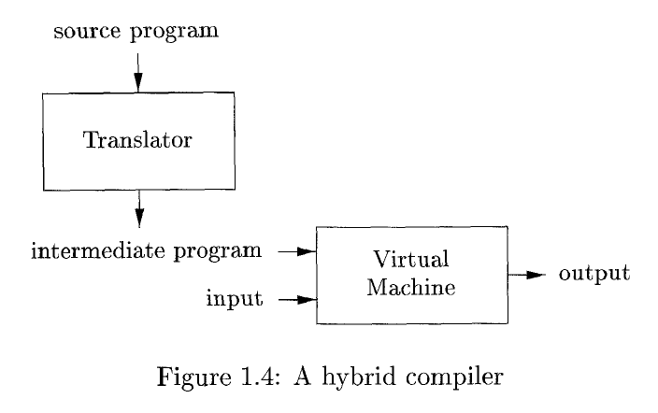
Example of Java Compilation Process
Java language processors combine compilation and interpretation.
A Java source program may first be compiled into an intermediate form called bytecodes. The bytecodes are then interpreted by a virtual machine.
A benefit of this arrangement is that bytecodes compiled on one machine can be interpreted on another machine.

Slide 12
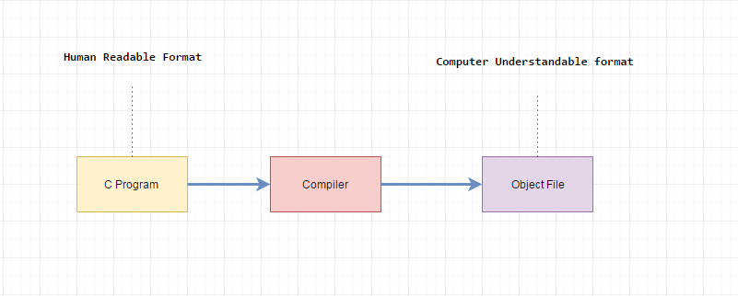
Compiler Construction
The process of constructing a compiler is called compiler construction
Why we need a construct compiler?
Machine is only understood binary language so it is important to use the compiler which help to convert the high-level language to low level language.
Anyone who does any software development needs to use a compiler. It is a good idea to understand what is going on inside the tools that you use.

Slide 13
Generations of Programming Languages
First Generation of PL (Machine Language)
Second Generation of PL (Assembly Language)
Third Generation of PL (Procedural Language)
Fourth Generation of PL (Very High Level Language)
Fifth Generation of PL

Slide 14
Evolution of Programming Languages (1GL)
The first electronic computers appeared in the 1940's and were programmed in machine language by sequences of 0's and 1's that explicitly told the computer what operations to execute and in what order.
The operations themselves were very low level: move data from one location to another, add the contents of two registers, compare two values, and so on.
This kind of programming was slow, and error prone.
Once written, the programs were hard to understand and modify.

Slide 15
Evolution of Programming Languages (2GL)
Assembly languages were introduced in 1950s to mitigate the error and excessively difficult nature of binary programming
The instructions in an assembly language were just mnemonic representations of machine instructions.
Most commonly used RISC, and CISC what our embedded system and desktop computer use

Slide 16
Evolution of Programming Languages (3GL)
Third generation of languages introduced in later 1950s are the primary language used in general purpose programming today
Designed for the easy use of programmer
Based on natural language
Use structural approach
C, C++, C#, Java, BASIC, COBOL are high level languages

Slide 17
Evolution of Programming Languages (4GL)
Fourth-generation languages are languages designed for specific applications like NOMAD for report generation, and SQL for database queries

Slide 18
Evolution of Programming Languages (5GL)
5th generation language introduced in 1990 is designed as constraint system.
Constraint-based instead of algorithmic
Used for ai research
LISP, PROLOG are the example of 5GL.

Slide 19
High Level Language
These are programmer-friendly languages that are manageable, easy to understand, debug, and widely used in today’s times.
These are very easy to execute.
High-level languages require the use of a compiler or an interpreter for their translation into machine code.
These languages have a very low memory efficiency. It means that they consume more memory than any low-level language.
High-level languages are human-friendly. They are, thus, very easy to understand and learn by any programmer.

Slide 20
Low Level Language
These are machine-friendly languages that are very difficult to understand by human beings but easy to interpret by machines.
These are very difficult to execute.
These languages have a very high memory efficiency. It means that they consume less energy as compared to any high-level language
Low-level languages are machine-friendly. They are, thus, very difficult to understand and learn by any human

Slide 21
Advantages of High Level Language
Easy to understand and debugging
Easy to execute
Portable from any one device to another.
High-level languages are human-friendly

Slide 22
Language Processing System
A source program may be divided into modules stored in a separate file. The task of collecting the source program is sometimes entrusted to a separate program called preprocessor.
The preprocessor may also expand shorthand’s called macros into source language statements.
The modified source program is then fed to a compiler.

Slide 23
Language Processing System
The compiler may produce an assembly language is easier to produce as output and easier to debug
The assembly language is then processed by a program called an assembler that produces relocatable machine code as its output.
Large programs are often compiled in pieces, so the relocatable machine code may have to be linked together with other relocatable object files and library files into the code that actually runs on the machine.

Slide 24
Language Processing System
It is a tool used to link part of a program together for execution into single executable file. A loader loads this executable file into the memory and do execution.
The linker resolves external memory addresses, where the code in one file may refer to a location in another file. The loader then puts together all of the executable object files into memory for execution.

Slide 25
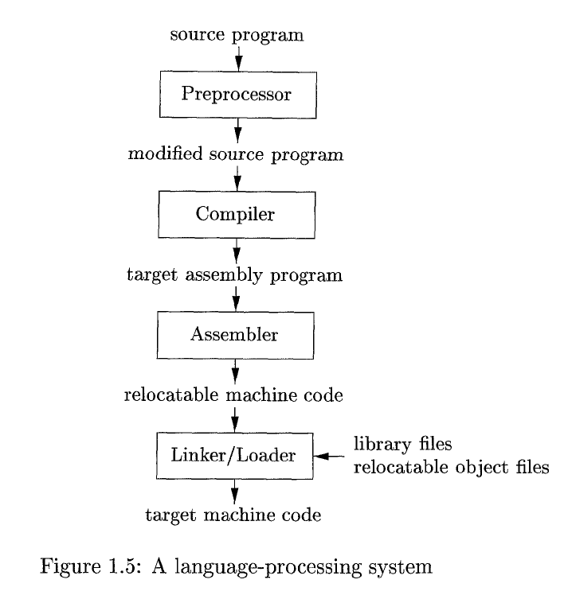

Slide 26
The Structure of a Compiler
There are two parts to this mapping: analysis and synthesis
Analysis
Determines the operations implied by the source program which are recorded in a tree structure
Synthesis
Synthesis takes the tree structure and translate the operation into the target program

Slide 27
The Structure of a Compiler
The analysis part breaks up the source program into constituent pieces and imposes a grammatical structure on them.
It then uses this structure to create an intermediate representation of the source program.
If the analysis part detects that the source program is either syntactically ill formed or semantically unsound, then it must provide informative messages, so the user can take corrective action.
The analysis part also collects information about the source program and stores it in a data structure called a symbol table

Slide 28
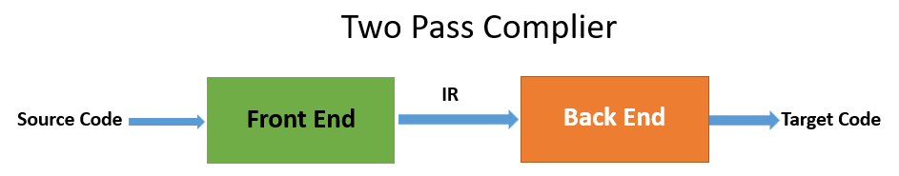
The Structure of a Compiler
The synthesis part constructs the desired target program from the intermediate representation and the information in the symbol table.
The analysis part is often called the front end of the compiler; the synthesis part is the back end.

Slide 29
The Structure of a Compiler (Lexical Analysis)
The first phase of a compiler is called lexical analysis or scanning.
The lexical analyzer reads the stream of characters making up the source program
Groups the characters into meaningful sequences called lexeme
For each lexeme, the lexical analyzer produces as output a token of the form
(token-name, attribute-value)
that it passes on to the subsequent phase, syntax analysis

Slide 30
The Structure of a Compiler (Lexical Analysis)
In the token, the first component token-name is an abstract symbol that is used during syntax analysis, and the second component attribute-value points to an entry in the symbol table for this token.
Information from the symbol-table entry is needed for semantic analysis and code generation
position = initial + rate * 60
After lexical analysis as the sequence of tokens
(Id,1) (=) (id,2) (+) (id,3) * (60)

Slide 31
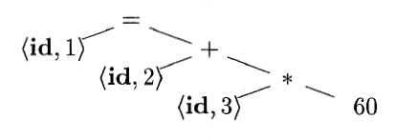
The Structure of a Compiler (Syntax Analysis)
The second phase of the compiler is syntax analysis or parsing.
The parser uses the first components of the tokens produced by the lexical analyzer to create a tree-like intermediate representation that depicts the grammatical structure of the token stream.
A typical representation is a syntax tree in which each interior node represents an operation and the children of the node represent the arguments of the operation
(Id,1) (=) (id,2) (+) (id,3) * (60)
Syntax tree

Slide 32
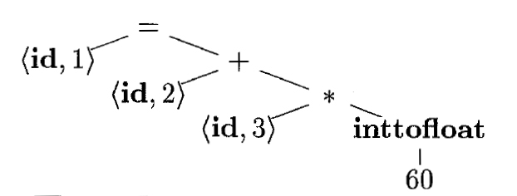
The Structure of a Compiler (Semantic Analysis)
The semantic analyzer uses the syntax tree and the information in the symbol table to check the source program for semantic consistency with the language definition.
It also gathers type information and saves it in either the syntax tree or the symbol table, for subsequent use during intermediate-code generation.
An important part of semantic analysis is type checking; the compiler must report an error if a floating-point number is used to index an array.

Slide 33
The Structure of a Compiler (Intermediate Code Generator)
In the process of translating a source program into target code, a compiler may construct one or more intermediate representations, which can have a variety of forms.
Syntax trees are a form of intermediate representation
After syntax and semantic analysis of the source program, many compilers generate an explicit low-level or machine-like intermediate representation.
This intermediate representation should have two important properties:
it should be easy to produce
it should be easy to translate into the target machine

Slide 34
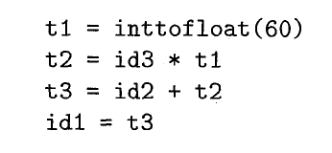
The Structure of a Compiler (Intermediate Code Generator)
Intermediate form called three-address code, which consists of a sequence of assembly-like instructions with three operands per instruction.
The output of the intermediate code generator
There are several points about three-address instructions.
First, each three-address assignment instruction has at most one operator on the right side.
Second, the compiler must generate a temporary name to hold the value computed by a three-address instruction.
Third, some "three-address instructions" like the first and last in the sequence, above, have fewer than three operands.

Slide 35
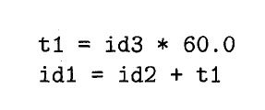
The Structure of a Compiler (Code Optimization)
The machine-independent code-optimization phase attempts to improve the intermediate code so that better target code will result.
Better means faster, but other objectives may be desired, such as shorter code, or target code that consumes less power.
The optimizer can deduce that the conversion of 60 from integer to floating point can be done once and for all at compile time.

Slide 36
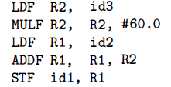
The Structure of a Compiler (Code Generator)
The code generator takes as input an intermediate representation of the source program and maps it into the target language.
Then, the intermediate instructions are translated into sequences of machine instructions that perform the same task.

Slide 37
